Slide 1
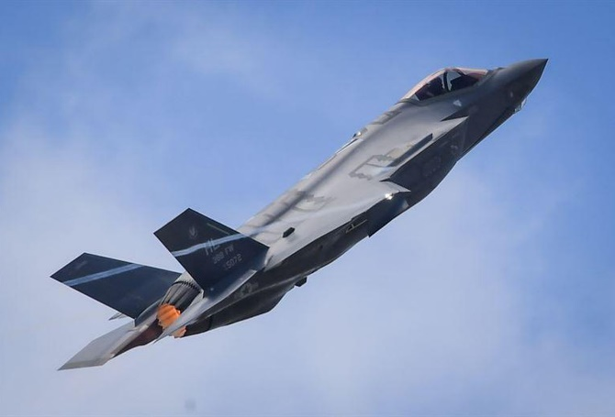
Design and Construction
Cost Engineering
Mr. Tom Hodges
Design & Construction Branch Chief
Facility Engineering Directorate
19 Mar 19

Slide 2
AFCEC Mission
AFCEC Mission
Provide Civil Engineering services & enterprise lifecycle leadership to Air Force installations that enable the warfighter
AFCEC Facilities Directorate
  Provide integrated facility engineering management, centralized program execution, design and construction expertise, and technical services that optimize Air Force and Joint capabilities through sustainable installations.
Notes:
Our MISSION is to provide civil engineering services and enterprise lifecycle leadership to Air Force installations that enable the warfighter.
AFCEC is installation focused and globally linked to provide best-practice solutions to Airmen…anytime and anywhere.
We are the cornerstone of the Civil Engineering enterprise by managing all centralized CE functions and optimizing key capabilities.
Now under Air Force Materiel Command, we are helping to form the foundation of the new Air Force Installation and Mission Support Center which fundamentally changes the way we provide support to our installations and the Air Force mission.
Ultimately to remain as, or be MORE responsive to the field.

Slide 3
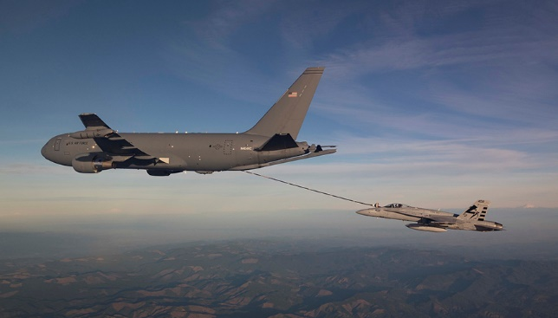
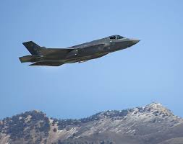
Challenges
Increased construction costs in regional hot markets & nationwide
Execution of High Visibility Projects (MILCON & FSRM)
  New Mission Beddown: F-35A, KC-46A, MQ-9,
    B-21, GBSD, VC-25B, CRH
  Corporate Initiatives/Chief Go-Do’s - Weapons Storage/Generation Facilities, BMT Recruit Recap, MIT-Lincoln Lab
  European Infrastructure Consolidation (EIC)
  European Deterrence Initiative (EDI)
  Asia Pacific Stabilization Initiative (APSI)
  FSRM - Runway Repair, Major Facility Renovations (MAJCOM HQ’s)

Slide 4
MILCON TIMELINE
FY-4
FY-3
FY-2
FY-1
FY
FY+1
O
N
D
J
F
M
A
M
J
J
A
S
O
N
D
J
F
M
A
M
J
J
A
S
O
N
D
J
F
M
A
M
J
J
A
S
O
N
D
J
F
M
A
M
J
J
A
S
O
N
D
J
F
M
A
M
J
J
A
S
O
N
D
J
F
M
A
M
J
J
A
S
O
PLAN
PROGRAM
DESIGN
CONSTRUCTION
Initial Parametric Cost Estimate
Final Parametric Cost Estimate
Budget Est Submission (SEP)
Pres Budget Submission (Feb)
Base Planning/Draft 1391
Base Submits Project to AFIMSC
AFCEC Planning Instruction
Planning Charrette/ 1391 Validation
MWG
A/E Validation of
Initial Estimate
Design Instruction
Design
Adv/Awd
Construction
Detailed A/E
Estimate
09 Feb 16
4

Slide 5
MILCON Cost Estimating
    Cost Estimating During Project Programming
      Bases develop initial cost estimates for projects prior to submission to AFIMSC (formerly to MAJCOMs)
      Initial Estimates are developed utilizing the Air Force’s parametric cost estimating tool, PACES.
      PACES is based on models of typical facility types, however, supporting facilities costs are estimated on a % of primary facility costs until more site investigations are completed
      For approved FYDP projects, cost and scope validation conducted for most of the program year FY+3 projects (In FY19 validating FY22 projects)
      Architect/Engineering (A/E) firm utilizes the cost estimating tool, Micro-Computer Aided Cost Estimating System (MCACES II Generation) a detail cost estimating software application
      Cost and scope validation efforts are conducted on site with a planning charrette involving users/installation organizations
      Many projects inserted late into program in FY-2 (FY21’s added in FY19)
      Finalized cost estimates used to adjust DD Form 1391’s

Slide 6
MILCON Cost Estimating
    Cost Estimating During Design
      A/E’s perform cost estimates at every design stage prior to construction award utilizing the MCACES II Generation tool with actual quantity take-offs from design documents. Consideration of local conditions, economy and market conditions are factored into the cost estimates, but after Programmed Amount cost has been established.
      Design Agents review, revise and approve all design estimates including final construction bid estimate
      Local market conditions and availability of materials and sub- contractor workforces can have a significant impact on bids

Slide 7
Air Force Challenges
Increasing number of high bids driving Congressional reprogrammings
Reprogrammings, when approved by Congress, do not come with additional funding
Increased reprogrammings = reduced funding availability
Lengthy reprogramming timelines drive bid extensions

Slide 8
MILCON Reprogramming Timeline
AUTHORIZATION COMMITTEES
APPROPRIATION COMMITTEES

Slide 9
Goals
Improve cost estimates to reflect current market conditions
More contract awards within approved funding
Reduce bid busts and reprogrammings

Slide 10
QUESTIONS
?

